Slide 1
ELEMENTARY STATISTICS, BLUMAN
Population Standard Deviation
© 2019 McGraw-Hill Education. All rights reserved. Authorized only for instructor use in the classroom. No reproduction or further distribution permitted without the prior written consent of McGraw-Hill Education.

Slide 2
Objectives for this PowerPoint
Understand the population variance and standard deviation, how they are calculated, and what they measure
Learn how to use the correct symbols for the population variance and standard deviation

Slide 3
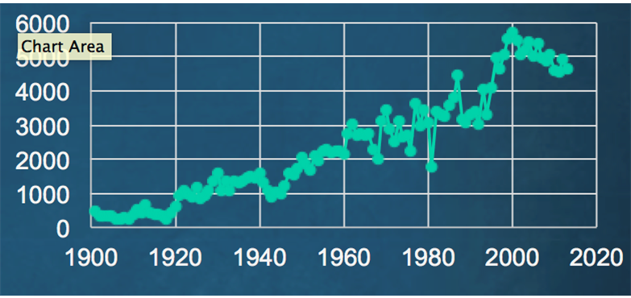
Major League Home Runs 1901 to 2013

Slide 4
Example
The mean for the number of home runs hit for both major leagues from the year 1901 to 2013 is 2346 home runs. But looking at the graph on the previous screen we can see a fair amount of fluctuation in the number of home runs hit from year to year particularly once we get past the 1960 season.
This brings up a question that is asked as frequently as any other in statistics. How much variation exists within the data?
One of the measures that is used to quantify variation in a data set is the variance. The variance is the average of the squared deviations between each data value and the mean.

Slide 5
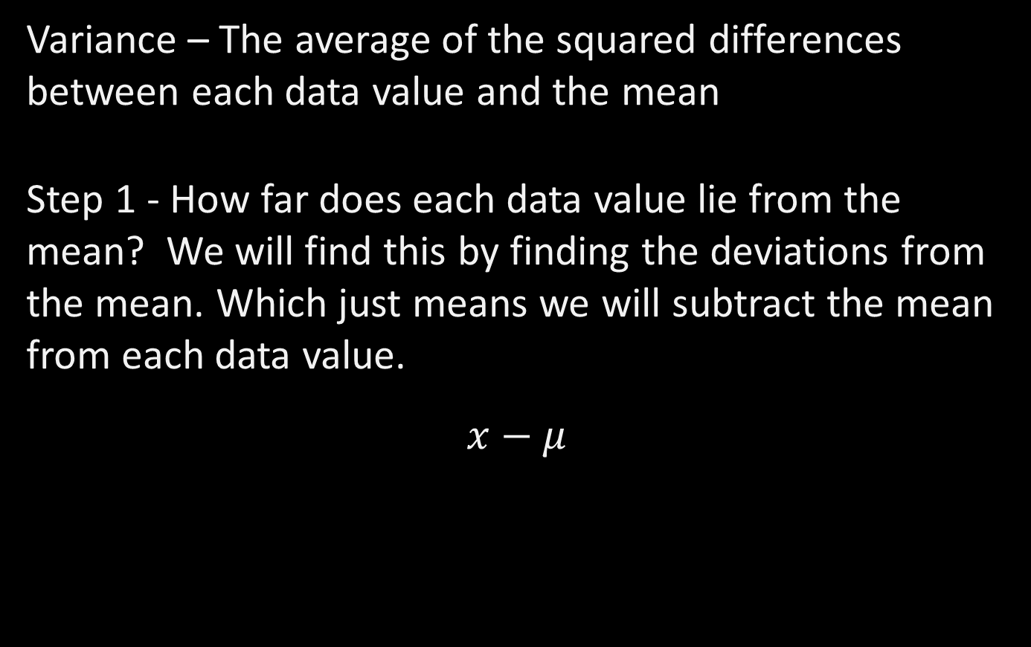
Step 1
Variance – The average of the squared differences between each data value and the mean
Step 1 - How far does each data value lie from the mean? We will find this by finding the deviations from the mean. Which just means we will subtract the mean from each data value.
$$x−μ$$

Slide 6
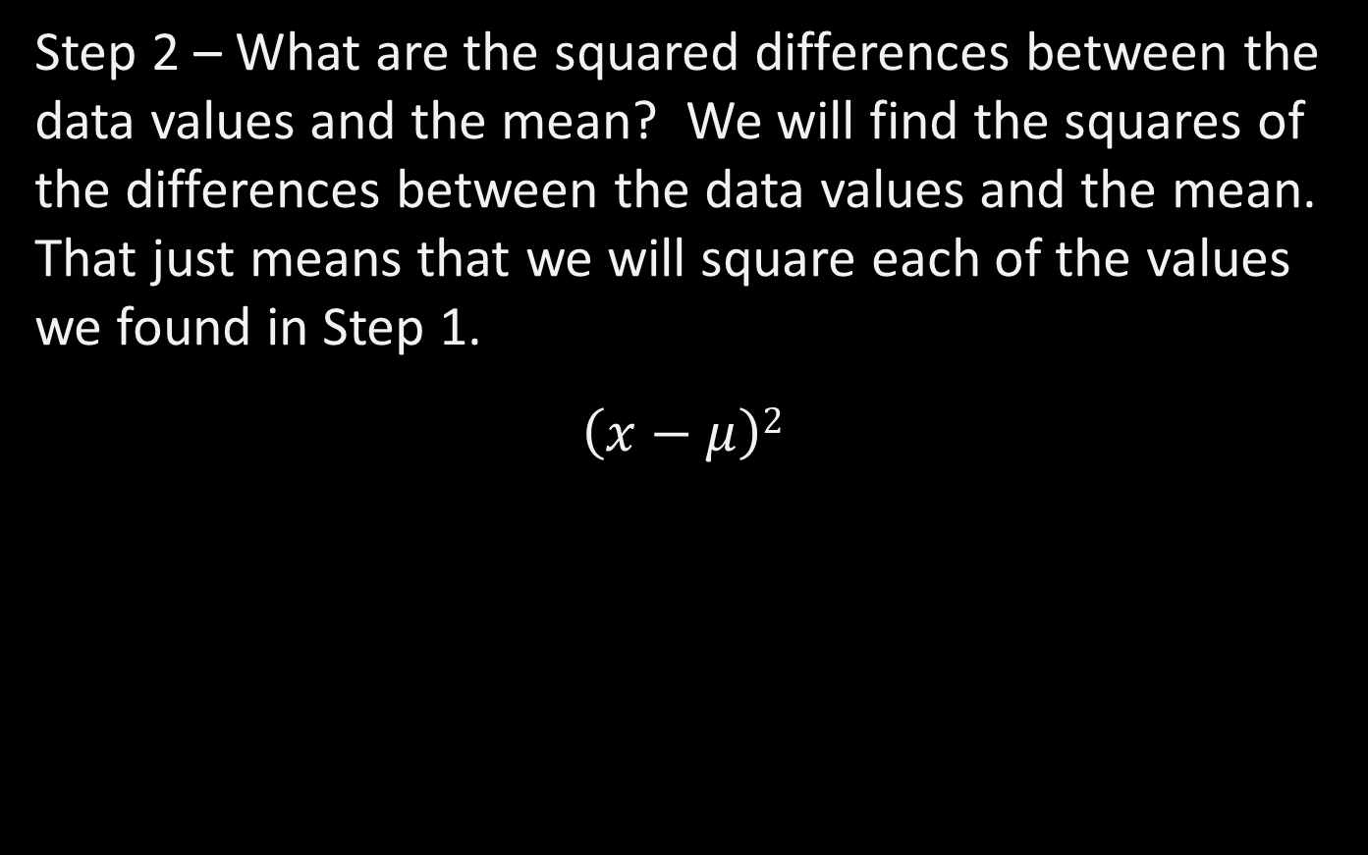
Step 2
Step 2 – What are the squared differences between the data values and the mean? We will find the squares of the differences between the data values and the mean. That just means that we will square each of the values we found in Step 1.
$$\left(x−μ\right)2$$

Slide 7
Step 3
Step 3 – What is the average of the squared differences between each data value and the mean? We will add up all of the values we found in Step 2 and divide by the size of the population.
The truncated table on the next slide contains the data used to form the home run time series graph. Notice that the table contains the year, the number of home runs and then two columns that we will complete with the deviations from the mean and their squares.
Recall that the general rounding rule tells us that we should do no rounding until the final calculation has been made. We are going to work with as many decimal places of the mean as is practical.

Slide 8
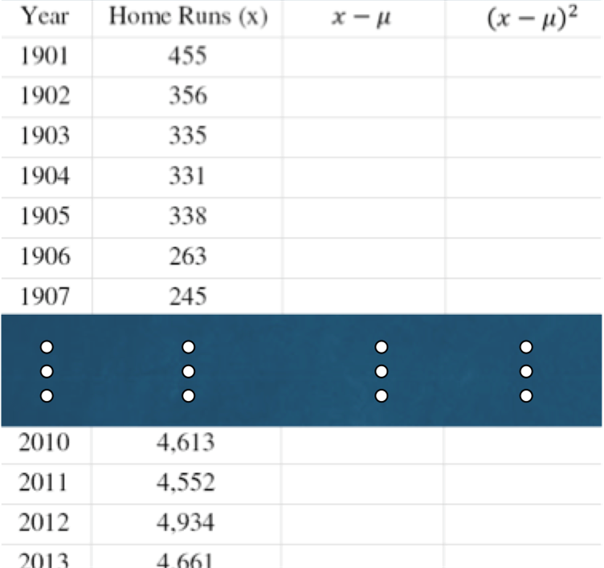
Table of Data Values

Slide 9
Subtract the Mean from the Data Value
To begin, subtract the mean from each data value. Recall that the mean is 2346. In the first row for the year 1901 that calculation will be 455 minus the mean. Once that calculation is done we will square it in the next column. We will continue this process until it is complete for each row in the table.
Note that the larger the deviation the larger this squared value will be.

Slide 10
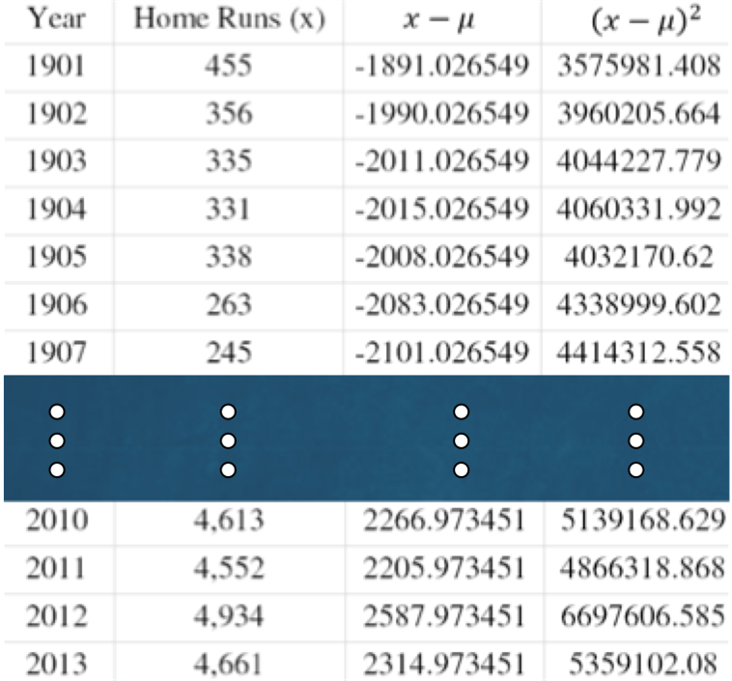
Completed Table

Slide 11
Population Variance
The population variance is given the symbol sigma squared.
Recall that it is the average of the squared deviations from the mean. We will need to add up all of the values in the last column.
This sum will give us 280615806.9

Slide 12

Use Formula
Substitute the appropriate numbers into the formula
$$\sum{\left(x−μ\right)2}=280615806.9$$
$$σ2=\frac{\sum{\left(x−μ\right)2}}{N}$$
$$σ2=\frac{280615806.9}{113}=2483325.7$$

Slide 13
Rounding Rule
The rounding rule for the variance is the same as the rounding rule for the mean. We should round to one more decimal place that occurs in the raw data. Our data are whole numbers. We should round the variance to one decimal place.
This brings up the problem of units. The mean for the home runs data set is 2346 home runs per season. The units for the mean are consistent with the units for the individual data values. This is why we can compare the mean to the individual data values when we subtract them in the formula for the variance. But during the process we squared those deviations and then found the mean for the squared deviations. That means that the units for the variance would be the square of the units for the mean.

Slide 14

Standard Deviation
The problem then is that we can't compare our measure of variation to the individual data values. The solution to that problem is to take the square root of the variance. The result will be a measure that we call the standard deviation. The units of the standard deviation would then be consistent with the units for the mean and the individual data values.
The rounding rule for the standard deviation is also to round to one more decimal place than occurs in the raw data.
$$σ=\sqrt{σ2}=\sqrt{2483325.725}=1575.9$$
The standard deviation for this population is 1575.9 home runs.

Slide 15
Summary
In this PowerPoint we learned the following:
To understand the population variance and standard deviation, how they are calculated, and what they measure
Learn how to use the correct symbols for the population variance and standard deviation

